Slide 1







Programming
SESSION
By Ahmed Abubakr

Slide 2



Contents
1
4
INTRODUCTION
WHAT IS PROGRAMMING
2
5
PROGRAMMING LEVELS
FIELDS OF PROGARAMMING
3
6
PROGRAMMING LANGUAGES
EXAMPLE

Slide 3



Introduction
Who Am I ?
Who Can Learn Programming ?
Why We Learn Programming ?

Slide 4





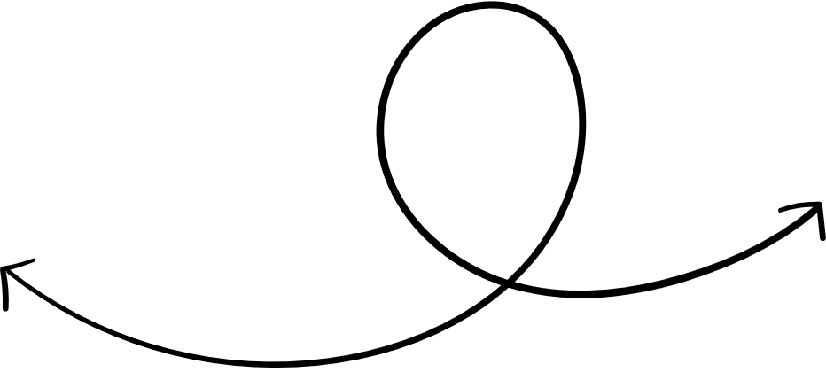


About me
Ahmed Mohamed Abubakr
Electrical Engineer
Ahmed Abubakr

Slide 5
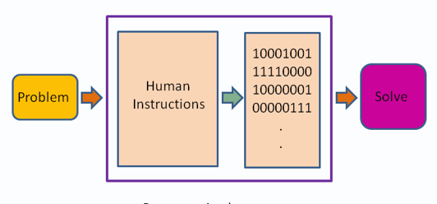
What is Programming
Writing a set of instructions that is executed by the machine to perform a specific task

Slide 6
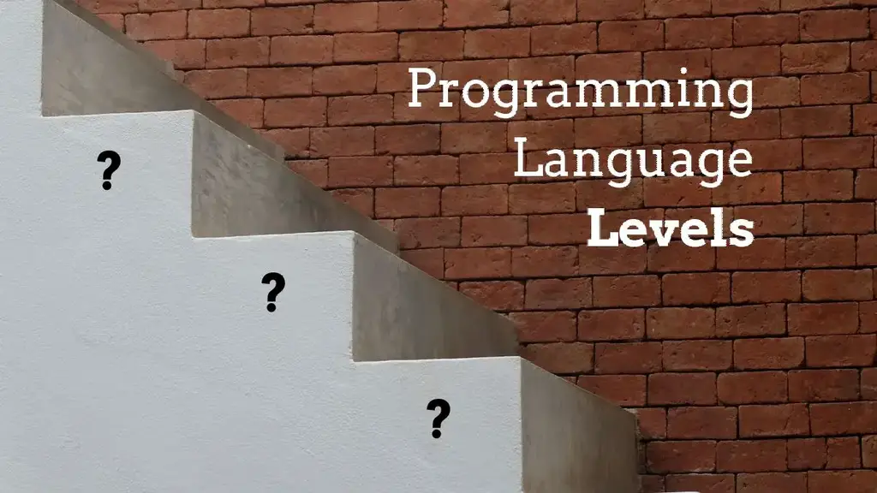

Slide 7
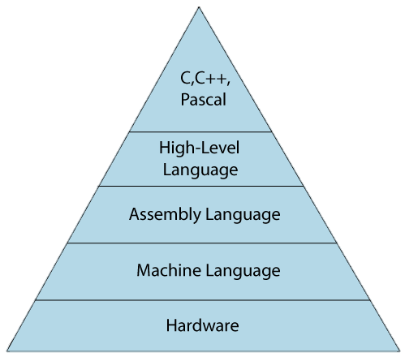
High level
Low level

Slide 8




Programming levels
Low level
High level
Machine Code and Assembly Language.
Java, Python, PHP, Perl, C#, JavaScript, etc.

Slide 9
Low-level language |  | High-level language
It is a machine-friendly language, i.e., the computer understands the machine language, which is represented in 0 or 1. |  | It is a user-friendly language as this language is written in simple English words, which can be easily understood by humans.
The low-level language takes more time to execute. |  | It executes at a faster pace.
It requires the assembler to convert the assembly code into machine code. |  | It requires the compiler to convert the high-level language instructions into machine code.
The machine code cannot run on all machines, so it is not a portable language. |  | The high-level code can run all the platforms, so it is a portable language.
It is memory efficient. |  | It is less memory efficient.
Debugging and maintenance are not easier in a low-level language. |  | Debugging and maintenance are easier in a high-level language.

Slide 10
Machine-level language |  | Assembly language
The machine-level language comes at the lowest level in the hierarchy, so it has zero abstraction level from the hardware. |  | The assembly language comes above the machine language means that it has less abstraction level from the hardware.
It cannot be easily understood by humans. |  | It is easy to read, write, and maintain.
The machine-level language is written in binary digits, i.e., 0 and 1. |  | The assembly language is written in simple English language, so it is easily understandable by the users.
It does not require any translator as the machine code is directly executed by the computer. |  | In assembly language, the assembler is used to convert the assembly code into machine code.
It is a first-generation programming language. |  | It is a second-generation programming language.

Slide 11




What is operating systems ?

Slide 12
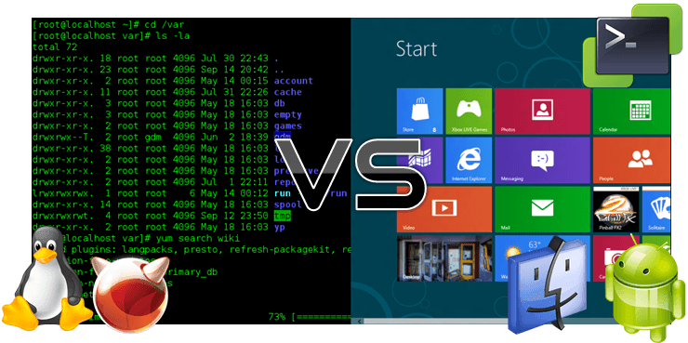
What is operating systems ?

Slide 13
f
What is extensions ?
File.jpg
File name
extension
Dot to separate

Slide 14



Web Development
Cyber security
Desktop applications
IOT
Fields of Programming
Android Applications
AI

Slide 15
Javascript
C++
Java
Programming Languages
C#
Perl
Python
PHP

Slide 16


Example
Lets be web developers and create a website

Slide 17
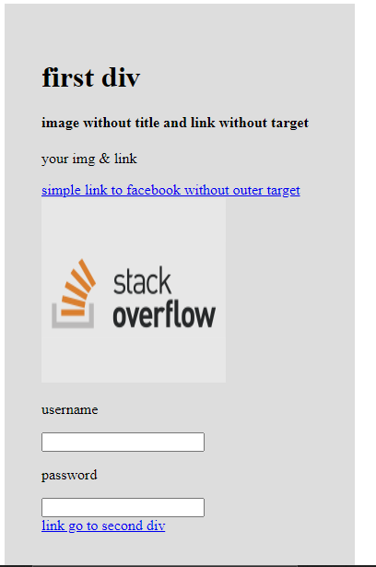
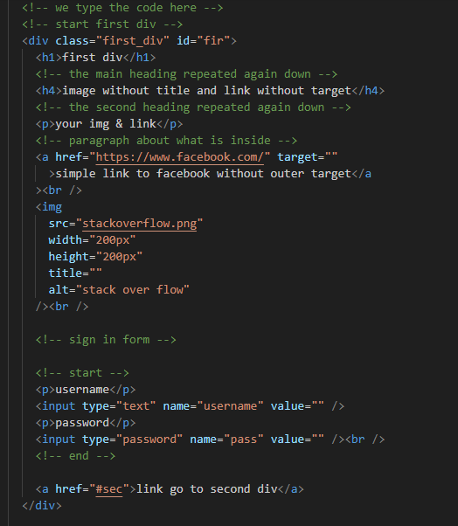
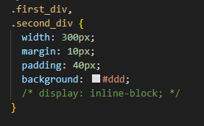

Slide 18


Slide 19


Slide 20
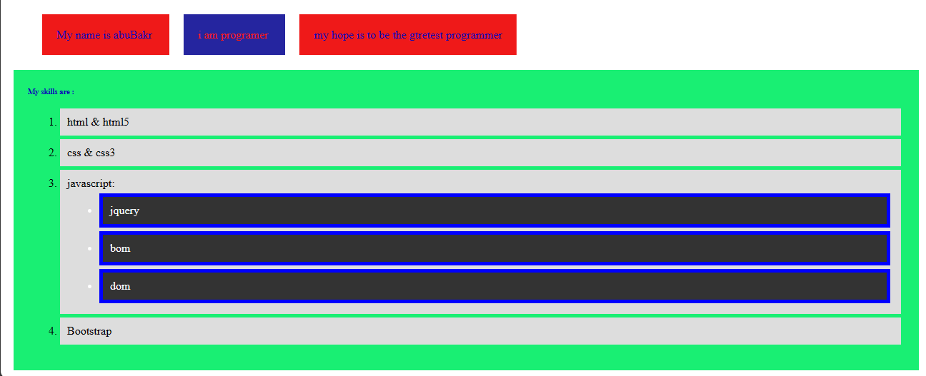
First Task

